Slide 2

Welcome

Slide 3
Jedi LODs Real World Examples
#Data17
Bronson Shonk
Frannie Makabenta
Tableau Software

Slide 4
Close your computer

Slide 5
Bronson Shonk
#Data17
Technical Support Analyst

Slide 6
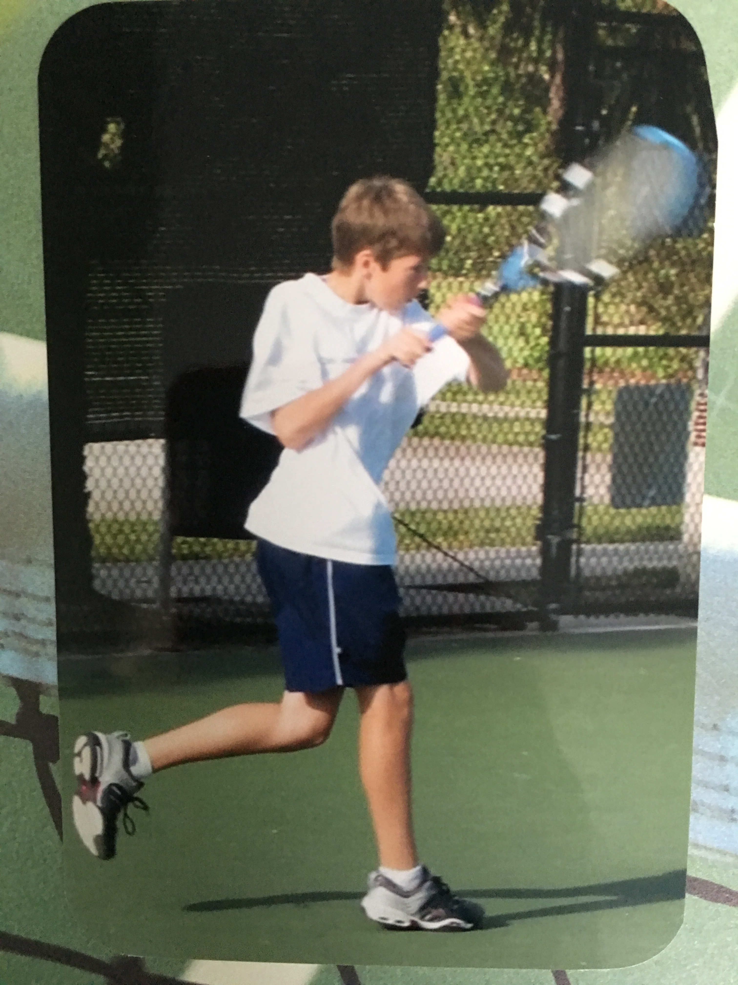

Slide 7
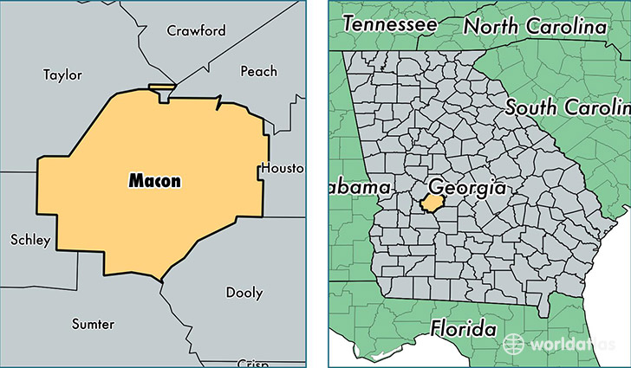

Slide 8
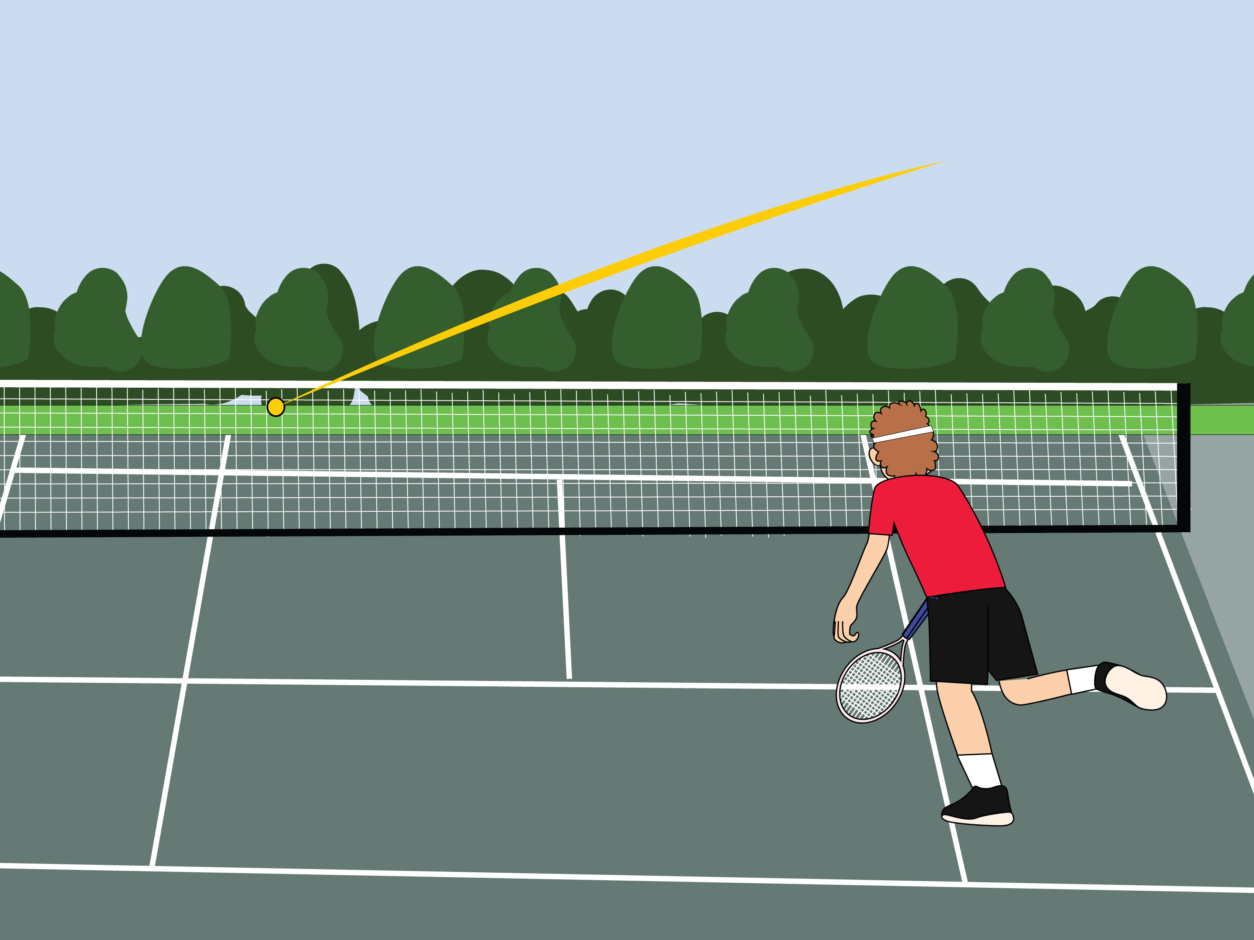

Slide 9
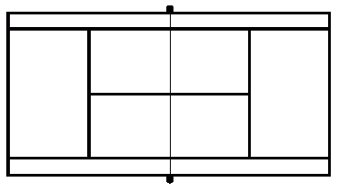

Slide 10
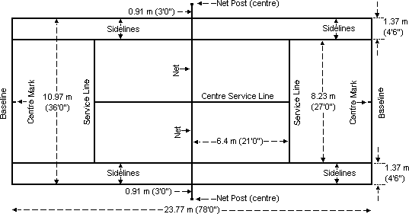

Slide 15
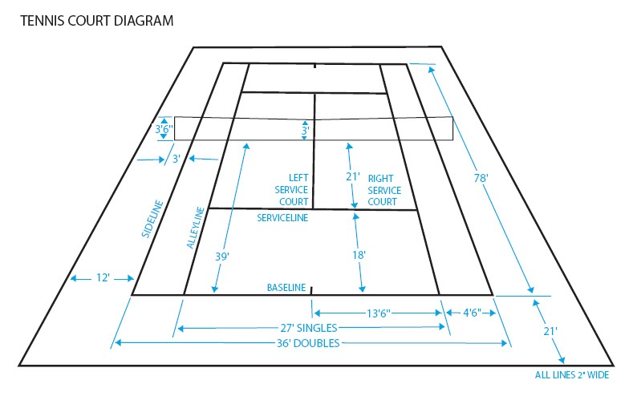

Slide 16
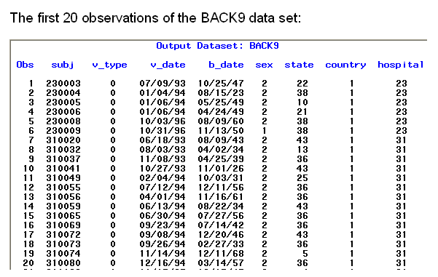

Slide 21
Frannie Makabenta
#Data17
Senior Product Consultant

Slide 22
Format
Guided Group Exercise/Walk-Through Concepts
Challenge Exercise
Questions? Our room assistants are happy to help!

Slide 23
Agenda
Comparisons
Bins
BREAK
3. Pivoting
4. Cohorts
Order of Operations

Slide 24
Your Focus in This Session
How the LODs are reshaping the data
Why the data needs to be reshaped
Practice putting this understanding to use

Slide 25
Materials
During Class:
Beginning Workbook
Guided Website
After Class:
Completed Workbook
PowerPoint
Guided Website
Work through the challenges here
See challenge prompts and step-by-step instructions for solutions
See completed vizzes and calculations

Slide 26
Comparisons

Slide 27
Pay attention to this section people!

Slide 28
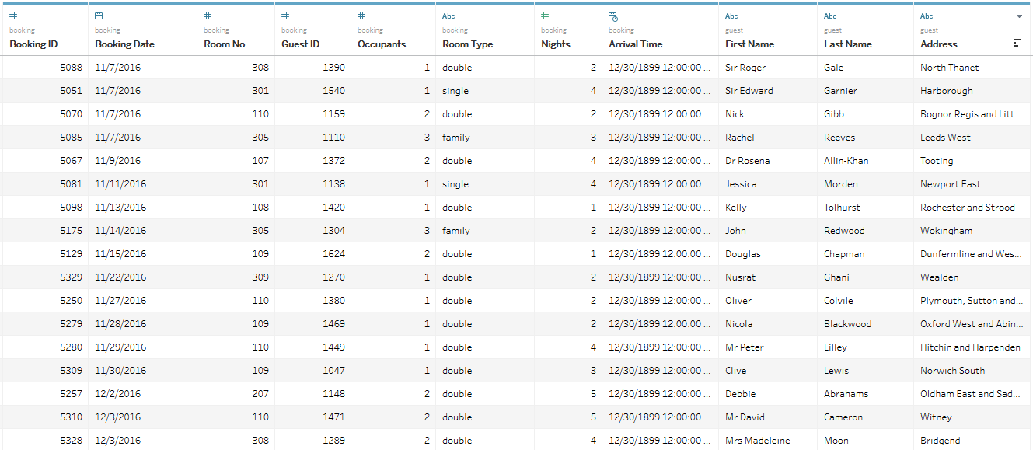
Bookings (Bed & Breakfast)

Slide 29
Each row represents a room reservation at a Bed & Breakfast.

Slide 30
Primary Key = Booking ID
Rooms are occupied multiple times (based on booking date)
Some guests have stayed multiple times

Slide 31
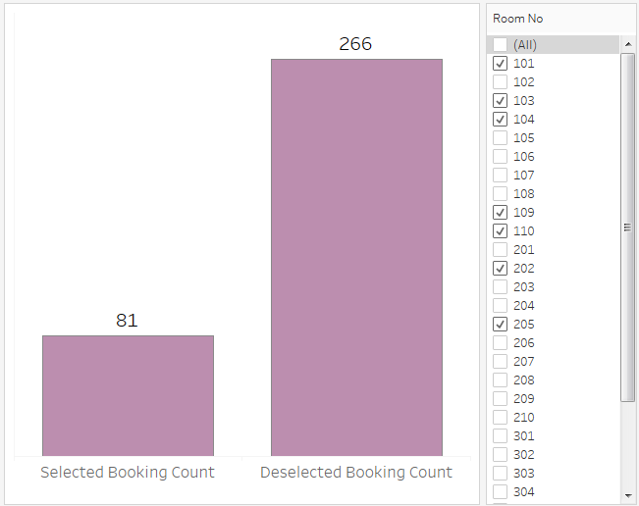
Example: Selected / Unselected
Compare the number of bookings for the selected room numbers to the number of bookings for the deselected room numbers.

Slide 32
✔
Selected
?
Deselected

Slide 33
✔
Selected
?
Deselected
?
All

Slide 34
?
?
✔
All – Selected = Deselected

Slide 35
SUM({FIXED : COUNTD([Booking ID])})
Wouldn’t this add the total booking ID for however many rows of data there are?

Slide 36
SUM({FIXED : COUNTD([Booking ID])})
Fixed on nothing = run across whole data set
No! The dimensions in the LOD always define the level that any calculation will be run at. That means we will not get duplication.

Slide 37
✔
✔
?
All – Selected = Deselected

Slide 38
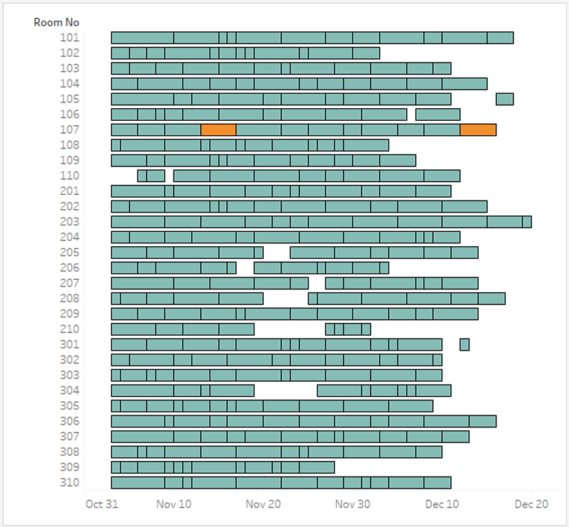
Exercise: Favorite Room
Who is the only guest that has stayed in the same room on different bookings?
This means the same guest booking the exact same room during separate stays.

Slide 39
Bins

Slide 40
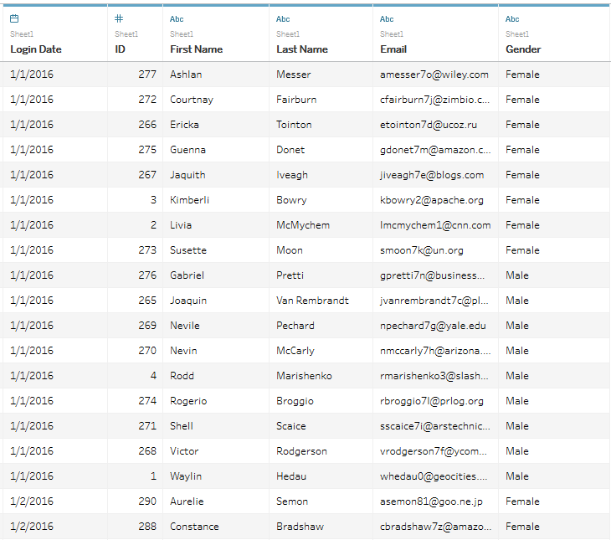
Web Logins

Slide 41
Each row represents a single login by a user.

Slide 42
ID + Login Date = Primary Key
Some user’s have logged on multiple times

Slide 43
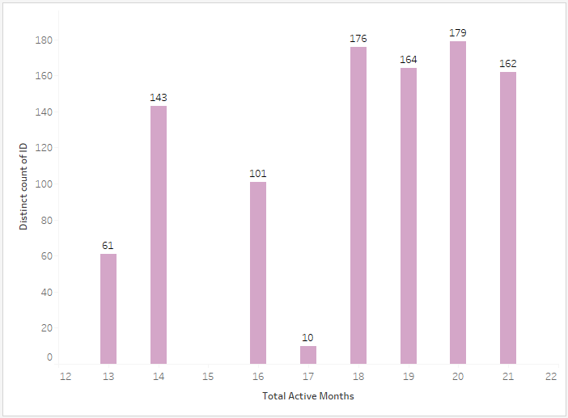
Example: Active Period
I'd like to see a bin of my users, based on the number of months they have been active.
You can define an active user by looking at the total months between their first and last login date.

Slide 44
Distinct Count of Users
✔
?
Active Month Bins

Slide 45
Define an active user by looking at total months between first and last login dates
?
?
Last Login Date - First Login Date
= Active Months

Slide 46
✔
✔
Last Login Date - First Login Date
= Active Months

Slide 47
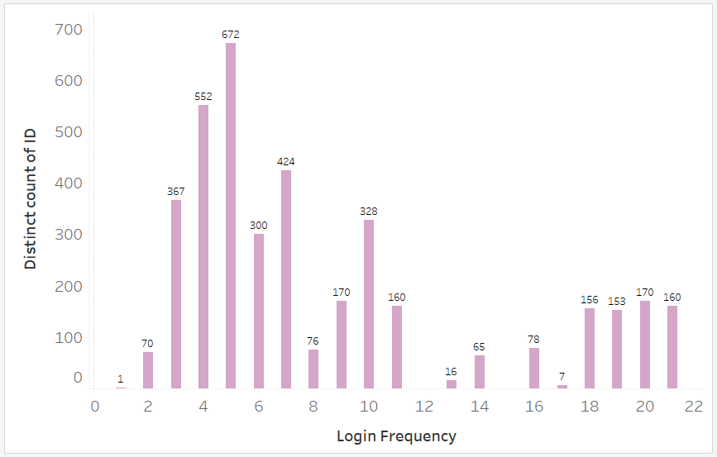
Exercise: Login Frequency
Now I'd like to see bins of my users, based on the average number of months between logins.

Slide 48
Average Login Frequency=
Active Months / # Gaps Between Logins

Slide 49
✔
Distinct Count of Users
✔
Active Month Bins
?
Total Gaps
Total Gaps = Total Logins - 1

Slide 50
Break Time Be back in 30 minutes

Slide 51
Pivoting

Slide 52
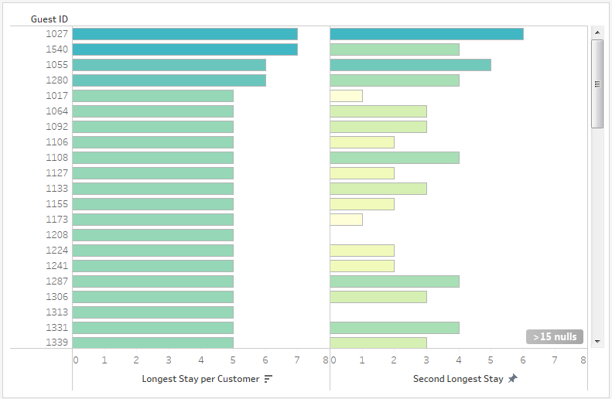
Example: Active Period
What is the longest stay?
How about the second longest stay?

Slide 53
Guest | Booking ID | Nights | Longest Night | Second Longest Night
John | 213219 | 2 | 6 | 4
John | 414354 | 4 | 6 | 4
John | 304235 | 6 | 6 | 4

Slide 54
Guest | Booking ID | Nights | Longest Night | Second Longest Night
John | 213219 | 2 | 6 | 4
John | 414354 | 4 | 6 | 4
John | 304235 | 6 | 6 | 4

Slide 55
Guest | Booking ID | Nights | Longest Night | Second Longest Night
John | 213219 | 2 | 6 | 4
John | 414354 | 4 | 6 | 4
John | 304235 | 6 | 6 | 4
GROUP BY : Aggregate
{ FIXED [Guest] : MAX([Nights]) }

Slide 56
Guest | Booking ID | Nights | Longest Night | Second Longest Night
John | 213219 | 2 | 6 | 4
John | 414354 | 4 | 6 | 4
John | 304235 | 6 | 6 | 4
GROUP BY : Aggregate
{ FIXED [Guest] : MAX([Nights]) }
Guest | Max Nights | Second Max Nights
John | 6 | 4

Slide 57
Guest | Booking ID | Nights | Longest Night | Second Longest Night
John | 213219 | 2 | 6 | 4
John | 414354 | 4 | 6 | 4
John | 304235 | 6 | 6 | 4
Guest | Max Nights | Second Max Nights
John | 6 | 4

Slide 58
Guest | Booking ID | Nights | Longest Night | Second Longest Night
John | 213219 | 2 | 6 | 4
John | 414354 | 4 | 6 | 4
John | 304235 | 6 | 6 | 4
Guest | Max Nights | Second Max Nights
John | 6 | 4

Slide 59
Guest | Booking ID | Nights | Longest Night | Second Longest Night
John | 213219 | 2 | 6 | 4
John | 414354 | 4 | 6 | 4
John | 304235 | 6 | 6 | 4
MAX( )
Guest | Max Nights | Second Max Nights
John | 6 | 4

Slide 60
Guest | Booking ID | Nights | Longest Night | Second Longest Night
John | 213219 | 2 | 6 | 4
John | 414354 | 4 | 6 | 4
John | 304235 | 6 | 6 | 4
IF [Nights] < [Longest Night] THEN [Nights] END
Guest | Max Nights | Second Max Nights
John | 6 | 4

Slide 61
Guest | Booking ID | Nights | Longest Night | Second Longest Night
John | 213219 | 2 | 6 | 4
John | 414354 | 4 | 6 | 4
John | 304235 | 6 | 6 | 4
{ FIXED [Guest] : MAX(
IF [Nights] < [Longest Night] THEN [Nights] END
) }
Guest | Max Nights | Second Max Nights
John | 6 | 4

Slide 62
Guest | Booking ID | Nights | Longest Night | Second Longest Night
John | 213219 | 2 | 6 | 4
John | 414354 | 4 | 6 | 4
John | 304235 | 6 | 6 | 4
Guest | Max Nights | Second Max Nights
John | 6 | 4

Slide 63
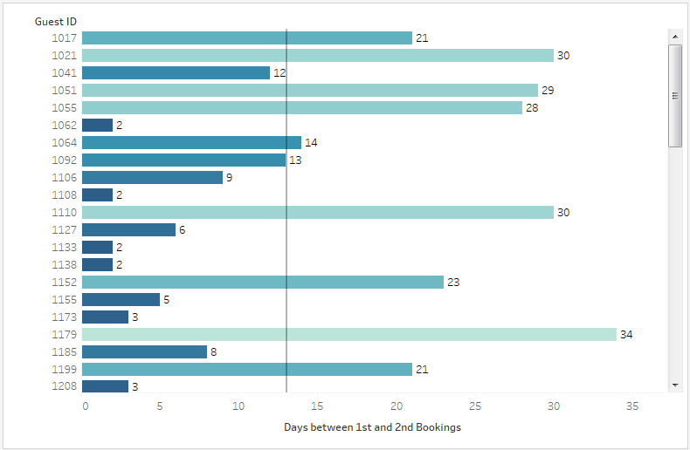
Exercise: Days until 2nd Booking
How many days did it take for guests to make a second booking?

Slide 64
Order of Operations

Slide 65
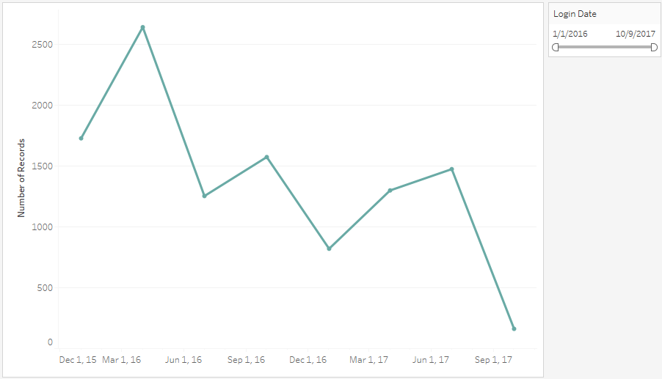
Example: Dynamic Dates 1
How do I create a dynamic date axis?
If the date filter spans more than 365 days, represent the data at a quarterly level.
If the data spans more than 100 days, show the data at a monthly level.
Otherwise, show the data at a daily level.
* Use COUNTD( ) to check how many dates are included in the filter

Slide 66
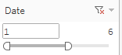
IF the filter includes less than 5 dates

Slide 67
IF the filter includes less than 5 dates
Show sales over time by date.

Slide 68
IF the filter includes less than 5 dates
Show sales over time by date.
IF the filter includes 5 or more dates

Slide 69
IF the filter includes less than 5 dates
Show sales over time by date.
IF the filter includes 5 or more dates
Show the total sales.

Slide 70
< 5 Dates
>= 5 Dates
Date | Sales
1 | 68
2 | 5434
3 | 54
4 | 34
5 | 43
6 | 111
7 | 45
8 | 665
9 | 5
10 | 4
Date | Sales
All | 6463

Slide 71
Date | Sales | # of Dates
1 | 68 | 1
2 | 5434 | 1
3 | 54 | 1
4 | 34 | 1
5 | 43 | 1
6 | 111 | 1
7 | 45 | 1
8 | 665 | 1
9 | 5 | 1
10 | 4 | 1
Date | Sales
1 | 68
2 | 5434
3 | 54
4 | 34
5 | 43
6 | 111
7 | 45
8 | 665
9 | 5
10 | 4

Slide 72
Date | Sales | # of Dates
1 | 68 | 1
2 | 5434 | 1
3 | 54 | 1
4 | 34 | 1
5 | 43 | 1
6 | 111 | 1
7 | 45 | 1
8 | 665 | 1
9 | 5 | 1
10 | 4 | 1
Date | Sales
1 | 68
2 | 5434
3 | 54
4 | 34
5 | 43
6 | 111
7 | 45
8 | 665
9 | 5
10 | 4
COUNTD( [Date] )

Slide 73
Date | Sales | # of Dates
1 | 68 | 1
2 | 5434 | 1
3 | 54 | 1
4 | 34 | 1
5 | 43 | 1
6 | 111 | 1
7 | 45 | 1
8 | 665 | 1
9 | 5 | 1
10 | 4 | 1
Date | Sales
1 | 68
2 | 5434
3 | 54
4 | 34
5 | 43
6 | 111
7 | 45
8 | 665
9 | 5
10 | 4
COUNTD( [Date] )

Slide 74
Date | Sales | # of Dates
1 | 68 | 10
2 | 5434 | 10
3 | 54 | 10
4 | 34 | 10
5 | 43 | 10
6 | 111 | 10
7 | 45 | 10
8 | 665 | 10
9 | 5 | 10
10 | 4 | 10
Date | Sales
1 | 68
2 | 5434
3 | 54
4 | 34
5 | 43
6 | 111
7 | 45
8 | 665
9 | 5
10 | 4
{ FIXED :
COUNTD( [Date] )
}

Slide 75
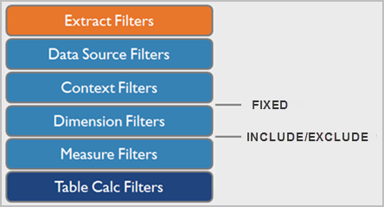

Slide 76
SELECT
[Date],
[subquery].[# of Dates],
FROM
sales_data
CROSS JOIN (
SELECT
COUNTD( [Date] ) AS '# of Dates'
FROM
sales_data) [subquery]
WHERE
[Date] BETWEEN 1 AND 6

Slide 77
SELECT
[Date],
[subquery].[# of Dates],
FROM
sales_data
CROSS JOIN (
SELECT
COUNTD( [Date] ) AS '# of Dates'
FROM
sales_data) [subquery]
WHERE
[Date] BETWEEN 1 AND 6

Slide 78
SELECT
[Date],
[subquery].[# of Dates],
FROM
sales_data
CROSS JOIN (
SELECT
COUNTD( [Date] ) AS '# of Dates'
FROM
sales_data) [subquery]
WHERE
[Date] BETWEEN 1 AND 6

Slide 79
SELECT
[Date],
[subquery].[# of Dates],
FROM
sales_data
CROSS JOIN (
SELECT
COUNTD( [Date] ) AS '# of Dates'
FROM
sales_data) [subquery]
WHERE
[Date] BETWEEN 1 AND 6

Slide 80
SELECT
[Date],
[subquery].[# of Dates],
FROM
sales_data
CROSS JOIN (
SELECT
COUNTD( [Date] ) AS '# of Dates'
FROM
sales_data) [subquery]
WHERE
[Date] BETWEEN 1 AND 6

Slide 81
Date | Sales | # of Dates
1 | 68 | 10
2 | 5434 | 10
3 | 54 | 10
4 | 34 | 10
5 | 43 | 10
6 | 111 | 10
7 | 45 | 10
8 | 665 | 10
9 | 5 | 10
10 | 4 | 10
Date | Sales
1 | 68
2 | 5434
3 | 54
4 | 34
5 | 43
6 | 111
7 | 45
8 | 665
9 | 5
10 | 4
{ FIXED :
COUNTD( [Date] )
}

Slide 82
Date | Sales | # of Dates
1 | 68 | 10
2 | 5434 | 10
3 | 54 | 10
4 | 34 | 10
5 | 43 | 10
6 | 111 | 10
7 | 45 | 10
8 | 665 | 10
9 | 5 | 10
10 | 4 | 10
Add To Context
Date | Sales
1 | 68
2 | 5434
3 | 54
4 | 34
5 | 43
6 | 111
7 | 45
8 | 665
9 | 5
10 | 4
{ FIXED :
COUNTD( [Date] )
}

Slide 83
Date | Sales | # of Dates
1 | 68 | 6
2 | 5434 | 6
3 | 54 | 6
4 | 34 | 6
5 | 43 | 6
6 | 111 | 6
7 | 45 | 10
8 | 665 | 10
9 | 5 | 10
10 | 4 | 10
Add To Context
Date | Sales
1 | 68
2 | 5434
3 | 54
4 | 34
5 | 43
6 | 111
7 | 45
8 | 665
9 | 5
10 | 4
{ FIXED :
COUNTD( [Date] )
}

Slide 84
Date | Sales | # of Dates
1 | 68 | 6
2 | 5434 | 6
3 | 54 | 6
4 | 34 | 6
5 | 43 | 6
6 | 111 | 6
7 | 45 | 10
8 | 665 | 10
9 | 5 | 10
10 | 4 | 10
Add To Context
Date | Sales
1 | 68
2 | 5434
3 | 54
4 | 34
5 | 43
6 | 111
7 | 45
8 | 665
9 | 5
10 | 4
IF the filter includes less than 5 dates
Show sales over time by date.
IF the filter includes 5 or more dates
Show the total sales.

Slide 85
Date | Sales | # of Dates
1 | 68 | 6
2 | 5434 | 6
3 | 54 | 6
4 | 34 | 6
5 | 43 | 6
6 | 111 | 6
7 | 45 | 10
8 | 665 | 10
9 | 5 | 10
10 | 4 | 10
Add To Context
Date | Sales
1 | 68
2 | 5434
3 | 54
4 | 34
5 | 43
6 | 111
7 | 45
8 | 665
9 | 5
10 | 4
IF the # of Dates < 5
Show sales over time by date.
IF the # of Dates >= 5
Show the total sales.

Slide 86
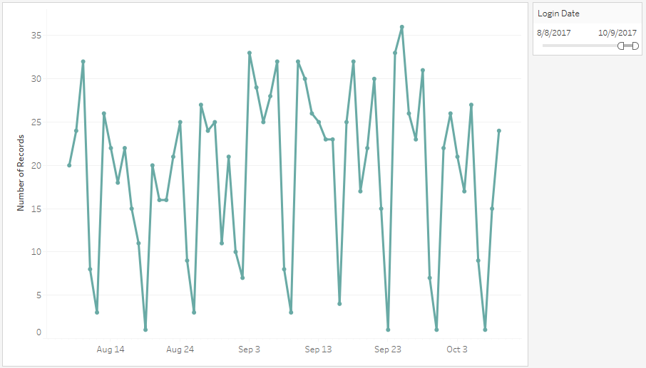
Exercise: Dynamic Dates 2
How do I create a dynamic date axis if I do not have data entered daily?
If the date filter spans more than 365 days, represent the data at a quarterly level.
If the data spans more than 100 days, show the data at a monthly level.
Otherwise, show the data at a daily level.
*Make this work even if I have days in which no data was recorded.

Slide 87
Filtering

Slide 88
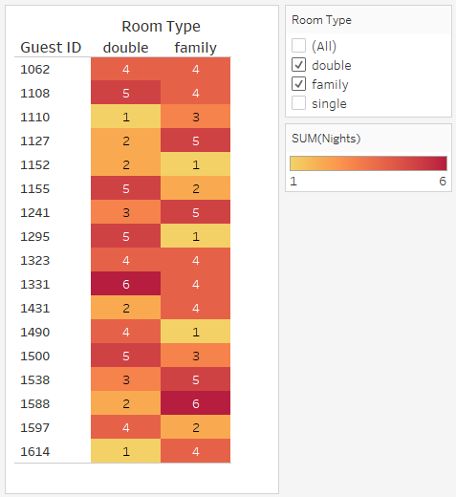
Example: Fixed Filtering
Show the Guest IDs that include at least all of the selected room types in the filter.
Make this work even when the Guest ID and Room Type are in the view, and utilize a context filter. Make sure your solution can scale to an indefinite number of Room Types.

Slide 89
Does the number of options selected in the filter equal the number of options for each individual in the view?

Slide 90
COUNTD( Room Types ) in the data set = COUNTD ( Room Types ) per guest

Slide 91
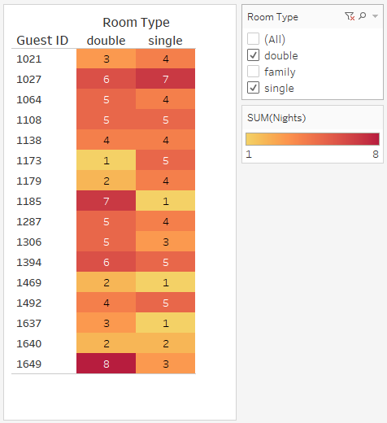
Exercise: Exclude Filtering
Show the Guest IDs that include at least all of the selected room types in the filter.
Only use EXCLUDE LODs. Make sure your solution can scale to an indefinite number of Room Types.

Slide 92
SESSION REPEATS
Day of Week, Month Day Session Title
Time – Time | Location
Day of Week, Month Day Session Title
Time – Time | Location
Day of Week, Month Day Session Title
Time – Time | Location

Slide 93
RELATED SESSIONS
Friday, October 23 Beginning Your Geographic Analysis Journey
11:30am – 12:30pm | Location
Friday, October 23 Beginning Your Geographic Analysis Journey
11:30am – 12:30pm | Location
Friday, October 23 Beginning Your Geographic Analysis Journey
11:30am – 12:30pm | Location

Slide 94
Resources

Slide 95
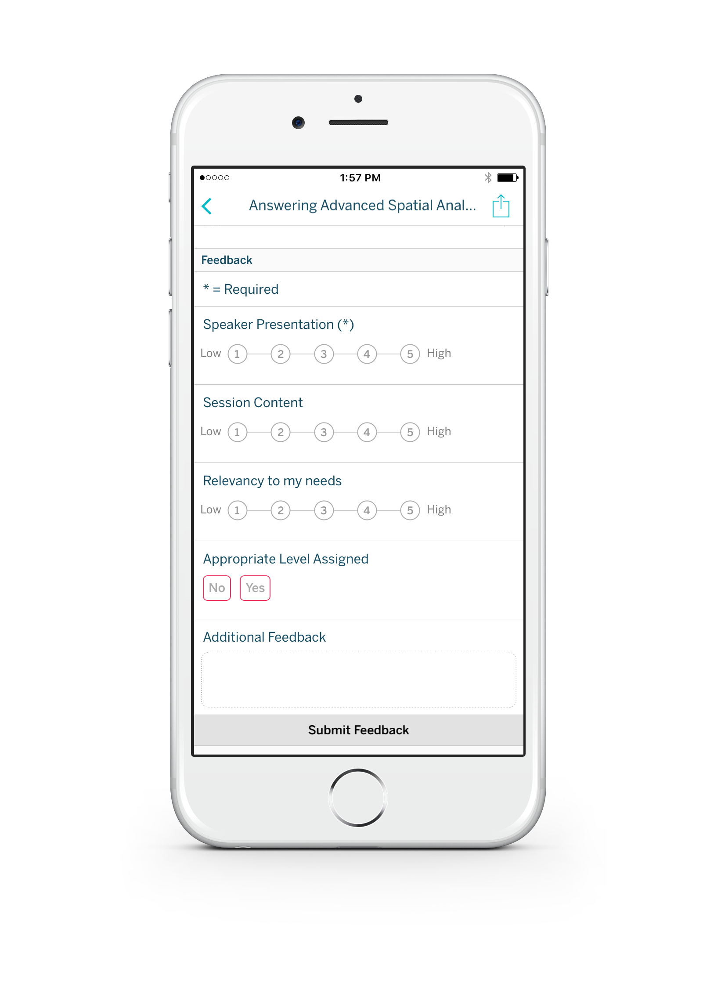
Please complete the session survey from the Session Details screen in your TC17 app

